Slide 1
Addition and Subtraction
Objectives
Day 1
WALT begin to use an empty number line to solve addition calculations.
Day 2
WALT begin to use an empty number line to solve addition calculations.
Day 3
WALT begin to use an empty number line to solve subtraction calculations.
Day 4
WALT begin to use an empty number line to solve subtraction calculations.

Slide 2
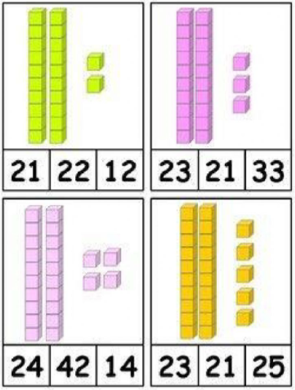
What is the correct number for each picture? Explain how you know.

Slide 3
Talk to your partner.
How could we work out
65 add 24?
Do we need to count back in ones?
What number facts can help?
We can add 20 by counting on 20 in 10s, and then add 4.
Count on two 10s from 65…
… 75, 85.
We know 5 + 4 is 9, so 65 + 24 is 89.

Slide 4
That’s was a lot to remember in our heads
so let’s try
65 + 24 on a number line.
Did you remember we have to write how much we are adding on top and the answer so far underneath?
Mark 65 at the number line. That leaves lots of room for our jumps.
One big jump of
20 to 85…
First we draw a straight line, this is our empty number line!
Now we just need to add the ones… 4 more
So now our number is not empty.
Is shows 65 + 24 = 89

Slide 5
Now let’s try 13 + 56
Which number should we put at the start? Why?
Always put the smaller number at the start.
That way you have less jumps to add!
On your whiteboards, copy the steps from the board to practise using an empty number line.
56 + 13 = 69

Slide 6
Write the number sentence
We will try 2 more together, watch all of the steps carefully on the Flipchart…
After, can you tell me all of the instructions for using an empty number line?
2. Draw a straight line
3. Write the first number at the start of the number line
4. Add the tens
5. Write the answer underneath the line
6. Add the ones
7. Write the answer underneath the line

Slide 7
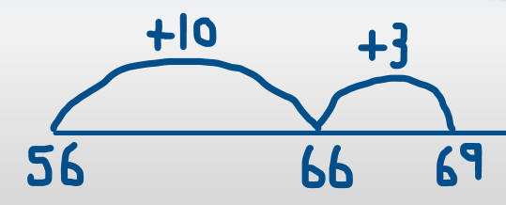
Draw your own empty number lines to solve these addition calculations
Group 1
23 + 4
33 + 6
13 + 12
26 + 21
42 + 15
31 + 25
Group 2
35 + 24
46 + 32
51 + 37
62 + 26
25 + 54
27 + 31
Write the number sentence
2. Draw a straight line
3. Write the first number at the start of the number line
4. Add the tens
5. Write the answer underneath the line
6. Add the ones
7. Write the answer underneath the line

Slide 8
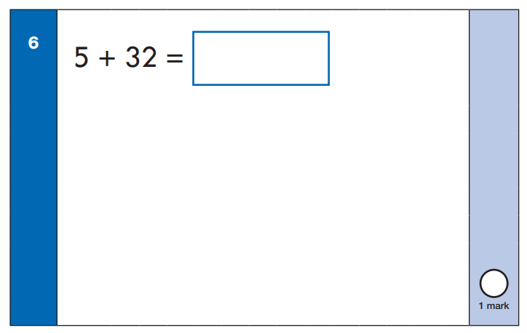
Tell a partner how you would solve this using an empty number line

Slide 9
Let’s try 22 + 36
Which number should we put at the start? Why?
Always put the smaller number at the start.
That way you have less jumps to add!
On your whiteboards, copy the steps from the board to practise using an empty number line.
22 + 36 = 58

Slide 10
Let’s try 35 + 47
Which number should we put at the start? Why?
What will be different this time when we add the ones?
It will bridge into the next ten. We can still use counting on to work out the answer.
35 + 47 = 82

Slide 11
Draw your own empty number lines to solve these addition calculations
Group 1
15 + 12
12 + 11
34 + 14
26 + 21
33 + 12
24 + 23
Group 2
72 + 14
63 + 32
43 + 26
54 + 28
29 + 42
25 + 63
26 + 48.
74 + 19
Write the number sentence
2. Draw a straight line
3. Write the biggest number at the start of the number line
4. Add the tens
5. Write the answer underneath the line
6. Add the ones
7. Write the answer underneath the line

Slide 12
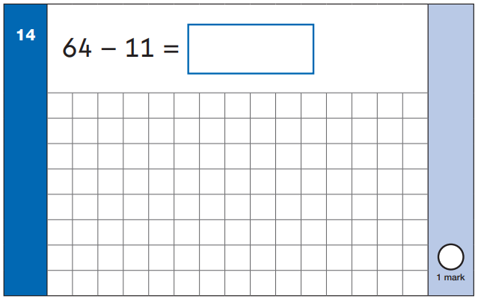
Could we solve this sum using an empty number line?
Could we put the numbers in any order?
What would the steps be?

Slide 13
We can use an empty line to solve subtraction questions too.
64 – 11 =
We put the starting number at this end for subtraction.
Why?
No!
We need to subtract the ones.
Now we are ready for the next step.
What should we do now?
Have we finished our subtraction?
64 – 11 = 53
Step two?
Step one?

Slide 14
78 – 25 =
On your whiteboards, copy the steps from the board to practise using an empty number line.

Slide 15
48 – 32 =
On your whiteboards, copy the steps from the board to practise using an empty number line.

Slide 16
Draw your own empty number lines to solve these addition calculations
Group 1
16 – 4
24 – 3
18 – 6
26 – 15
19 – 7
38 – 14
Group 2
35 – 14
63 – 22
77 – 52
62 – 41
38 – 25
89 – 26
Write the number sentence
2. Draw a straight line
3. Write the first number at the end of the number line
4. Subtract the tens
5. Write the answer underneath the line
6. Subtract the ones
7. Write the answer underneath the line

Slide 17
What do you notice about this subtraction sum?
24 – 71 =

Slide 18
Let’s try 35 - 23
Which number should we write first? Where?
Always put the bigger number at the end.
That way we are working backwards to take away!
On your whiteboards, copy the steps from the board to practise using an empty number line.
35 – 23 = 12

Slide 19
Let’s try 63 - 25
On your whiteboards, copy the steps from the board to practise using an empty number line.
We are going to need to count back into the tens below…
What is going to happen when we subtract our ones here?
So 63 – 25 = 38

Slide 20
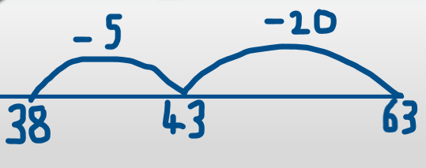
Draw your own empty number lines to solve these addition calculations
Group 1
18 - 5
39 - 4
35 - 5
26 - 13
23 - 21
12 - 3
Group 2
63 - 42
73 - 36
37 - 27
83 - 34
56 - 25
47 - 29
Write the number sentence
2. Draw a straight line
3. Write the first number at the end of the number line
4. Subtract the tens
5. Write the answer underneath the line
6. Subtract the ones
7. Write the answer underneath the line

